Slide 1
Quick guide to editing/updating the iCanClean plugin
Author: Roehl-Dean Reyes
2022-06-01

Slide 2
Overview
The iCanClean plugin has 3 main files:
eegplugin function – integrates plugin into the main EEGLAB window
pop function – pulls up the iCanClean GUI window, or accepts options from command line
signal processing function – computes the iCanClean cleaning algorithm based on specified options

Slide 3
The eegplugin function – what does it do?
File name: eegplugin_iCanClean.m
Allows the plugin directory to be recognized as an EEGLAB extension.
(This is handled automatically by EEGLAB as long as the function follows the naming scheme eegplugin_pluginName.m)
Creates a submenu for the plugin in the main EEGLAB window
Creates a callback to the pop function w/o specifying options, causing the GUI to appear
Specifies how the plugin interacts with the EEGLAB history mechanism

Slide 4
The eegplugin function – when to edit?
If the plugin isn’t listed during the EEGLAB initialization sequence…
This happens when the eegplugin function isn’t properly named, or the instance of EEGLAB is called from a different directory.
If you want to move, add, or delete submenus for the plugin within the main EEGLAB window.
If you want to change the post-execution and/or history-related behaviors of the plugin.
If you want to change what happens when the plugin submenu is clicked.

Slide 5
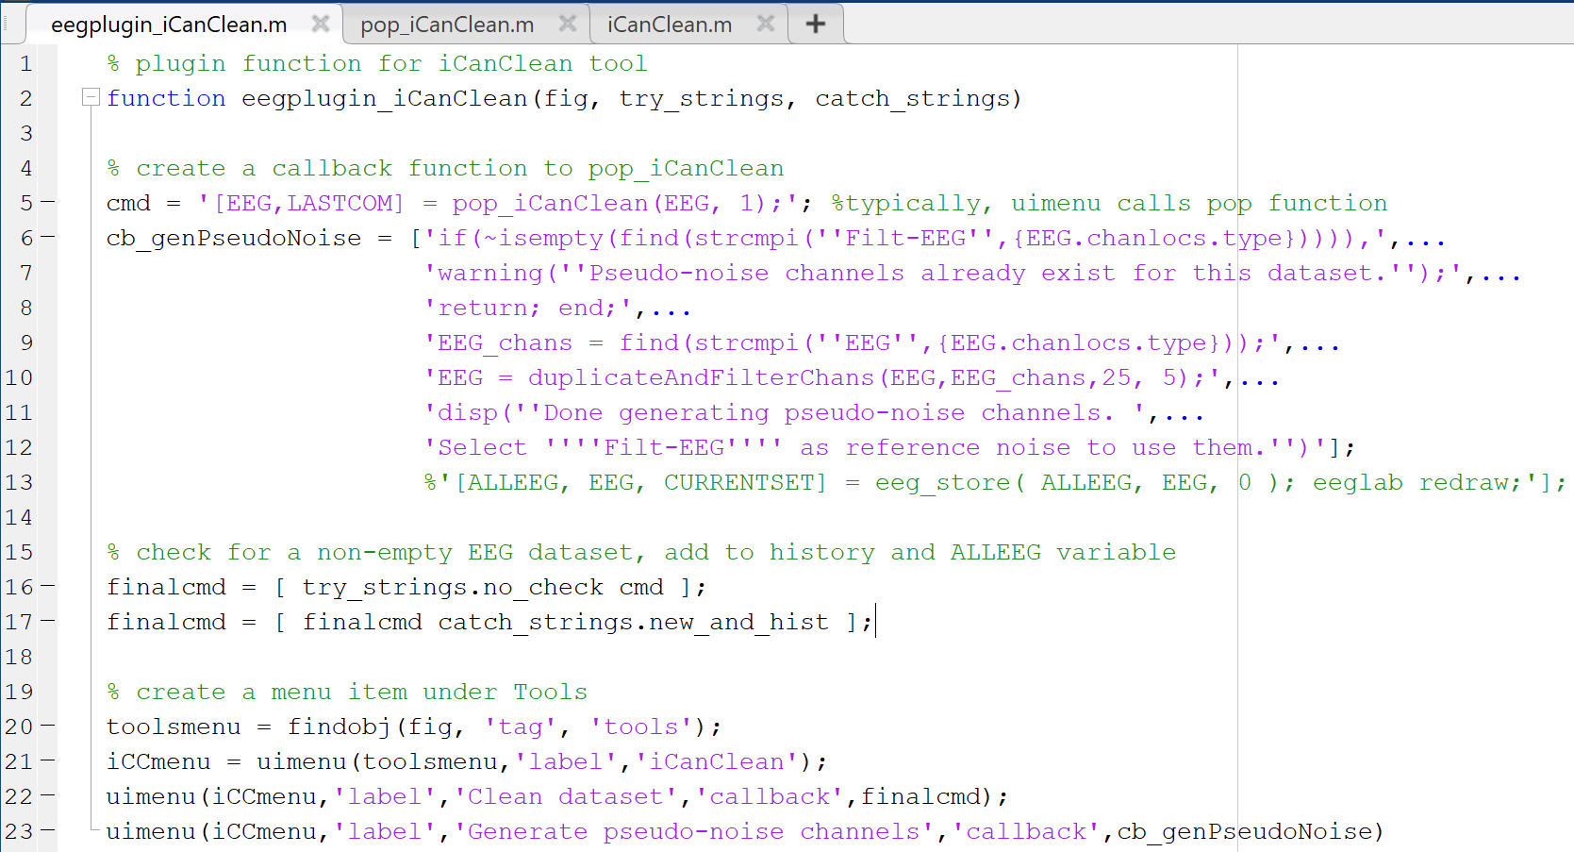
eegplugin_iCanClean.m (2022-06-02)
Function name. Should always have these three inputs.
A callback is simply a string of MATLAB code. It is executed upon interaction with a GUI element.
Since single quotes are used to specify MATLAB strings, two single quotes are needed to specify a single quote character within a string.
Tacks on additional commands to the front and back of the original callback. The try_strings and catch_strings structs contain options for different behaviors specified by EEGLAB.
Grabs the figure handle of the Tools menu in the EEGLAB window. Each subsequent uimenu function creates a submenu under the specified figure handle.

Slide 6
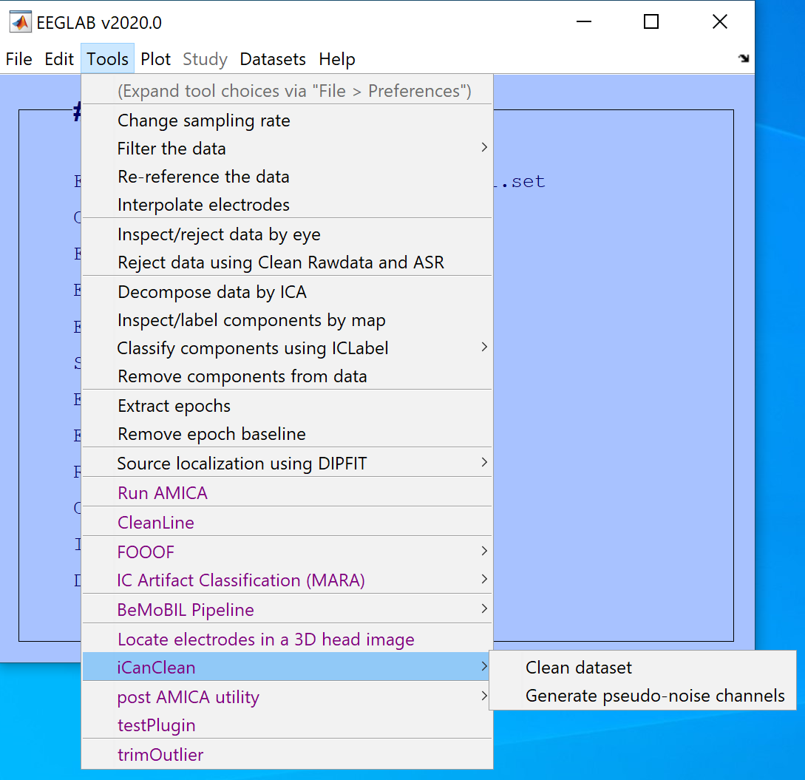
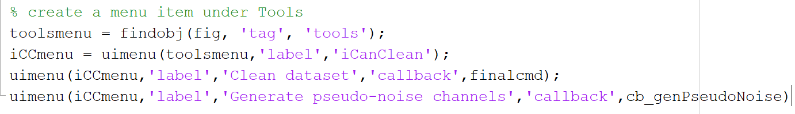
EEGLAB window – submenu creation
Clicking these submenus executes their respective callbacks.

Slide 7
The eegplugin function – useful functions
findobj – returns handle of specified figure.
uimenu – creates submenu, returns handle of newly created submenu.
Use >> help <function name> for more details. (e.g. help uimenu)
The EEGLAB window figure handle
Within the specified figure, find the handle of the element with the tag “Tools”.
The resulting handle to the “Tools” menu is returned here.
The handle to the newly created submenu is returned here.
The “Tools” menu handle
Gives the submenu the label “iCanClean.”

Slide 8
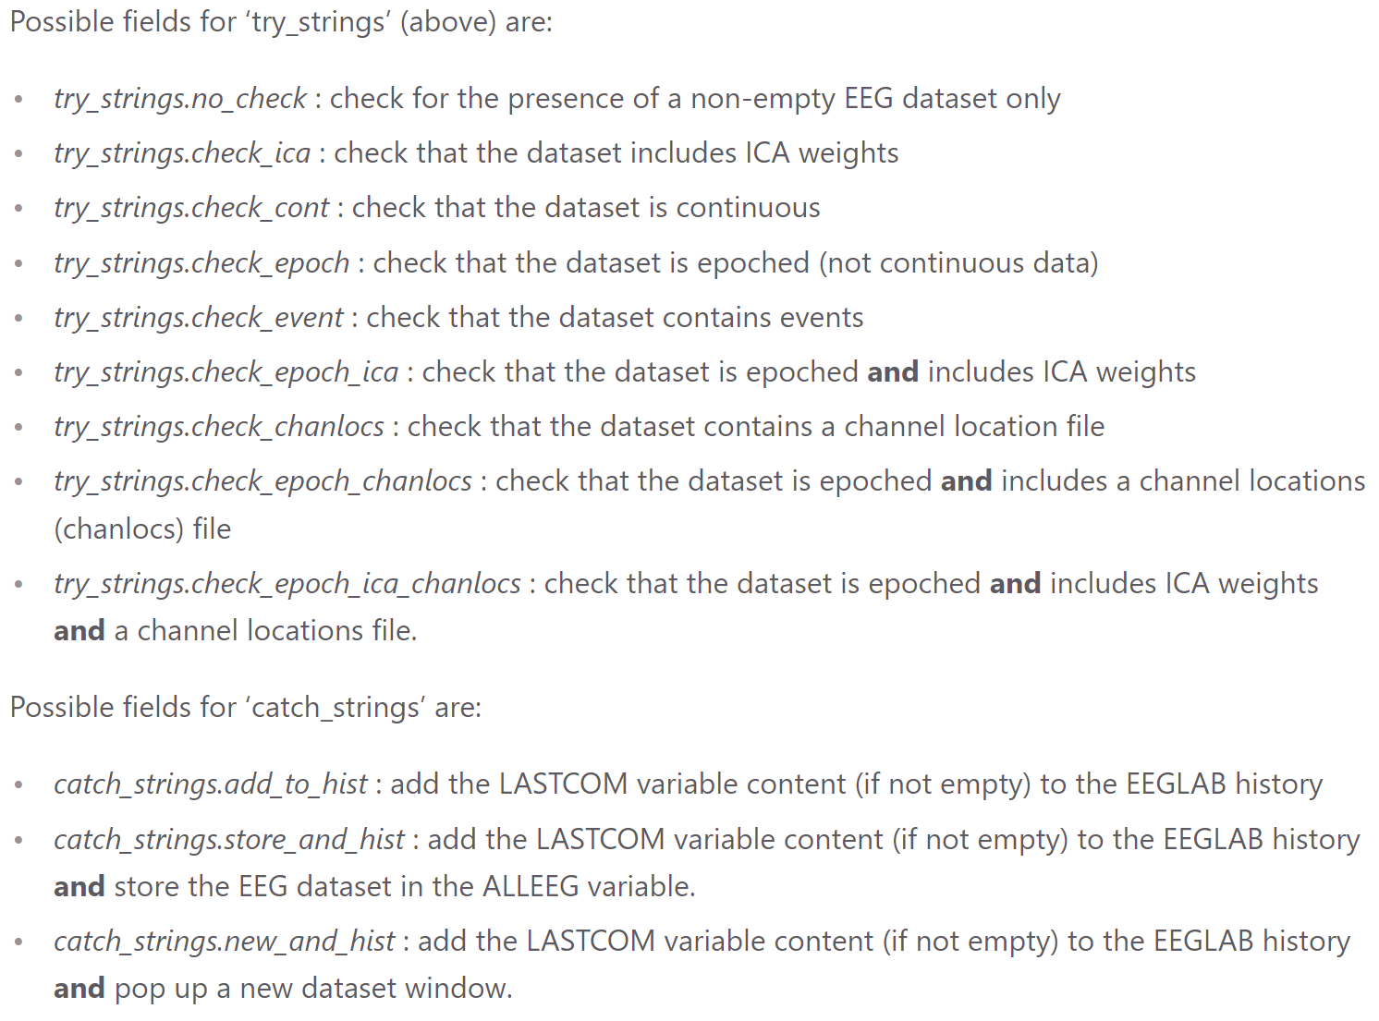
The eegplugin function – history mechanism
The try_strings and catch_strings commands have a set of options, listed to the left.
The try_strings struct is always prefixed to the pop function callback, while the catch_strings struct is appended at the end. Thus, the final command consists of the try_strings option, the pop function callback, and the catch_strings option in that order.

Slide 9
The pop function – what does it do?
File name: pop_iCanClean.m
Prints help description if < 2 arguments are specified.
Pulls up the iCanClean GUI window if < 3 arguments are specified.
Parses the GUI options into a properly formatted params struct, then calls the iCanClean signal processing function.
Otherwise, accepts additional options in the format of key-value pairs and calls the iCanClean signal processing function with these options.
Returns a string of the function call with additional options listed as key-value pairs.
This happens regardless of whether the options are specified in the GUI or the command line.

Slide 10
The pop function – when to edit?
If you want to change the appearance of the iCanClean GUI window.
If you want to edit the default values that appear in the GUI.
If you want to edit the default values for key-value pairs in the command line call.
If you want to change the behaviors of GUI elements (e.g. buttons, dropdown menus, checkboxes).

Slide 11
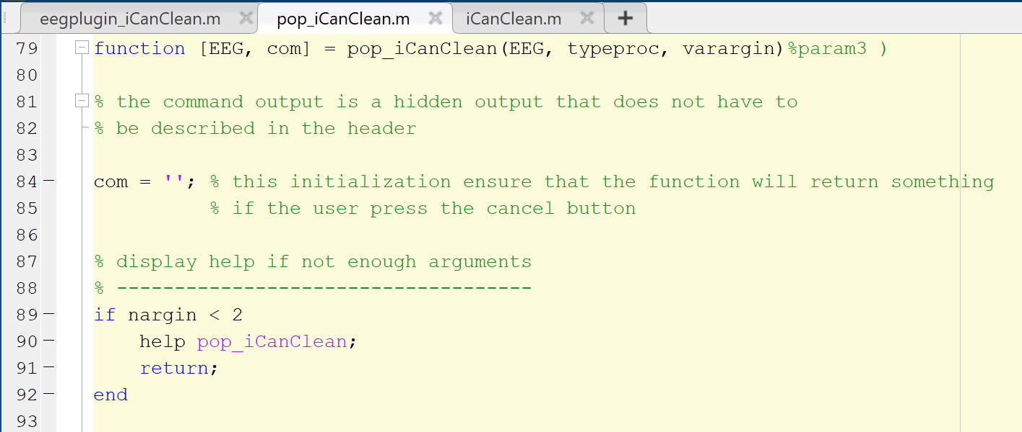
pop_iCanClean.m (2022-06-06), page 1
The function accepts two main inputs:
EEG – the main structure containing your EEG dataset
typeroc – boolean determining type of processing.
1 for raw data
0 for ICA components
*Note: at this time (2022-06-06), only raw data processing is supported. (typeroc always = 1)
The varargin input stands for variable argument input. This is a MATLAB function that allows any number of additional arguments to be accepted by the function. The varargin variable acts is a cell array that stores these additional arguments.
This conditional causes the function to print description and return early if there are not enough arguments.
Another MATLAB function, nargin – number of arguments input, returns the number of arguments used when the encapsulating function was called.

Slide 12
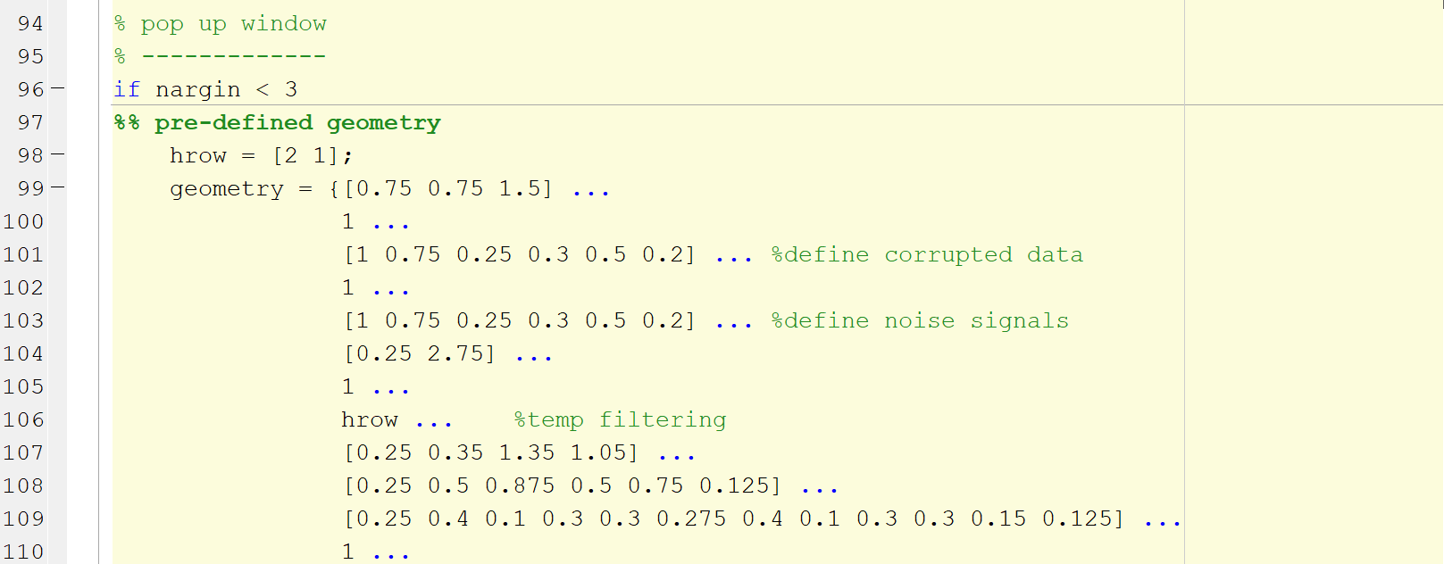
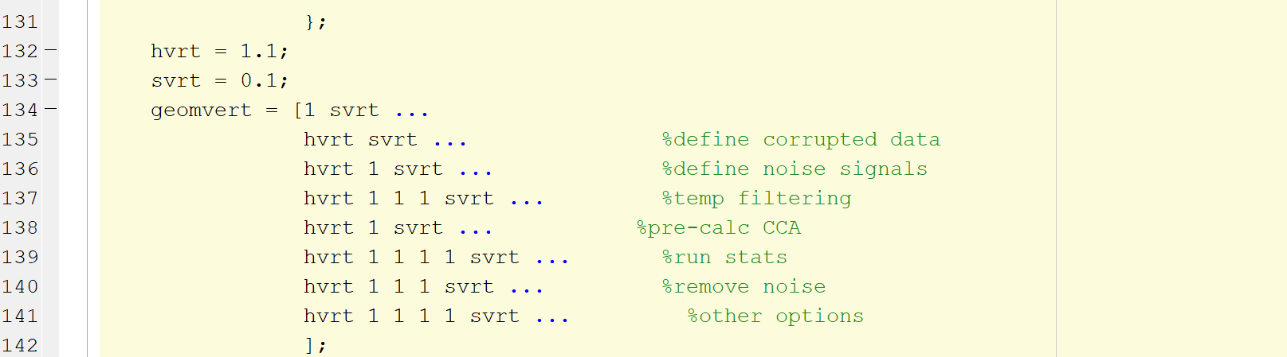
pop_iCanClean.m (2022-06-06), page 2
To make the GUI, a few variables need to be pre-defined.
The geometry variable is a cell array containing information for the horizontal space reserved for each GUI element.
A single cell contains the information for a single row in the GUI window (i.e. the number of elements in this cell array should equal the number of rows in the GUI).
For example, the first row, [0.75 0.75 1.5], means that there are two GUI elements of equal length on the left half, and one GUI element twice the length on the right half. Note that these numbers are relative lengths, not absolute, and thus do not have any units.
The geomvert variable is a double array defining the vertical space allotted to each row in the GUI.
Dimensionality is 1xN, where N is the number of rows.
Once again, the values here are relative sizes.
*Note: this is not the full geometry array, a section has been cut out for readability.

Slide 13
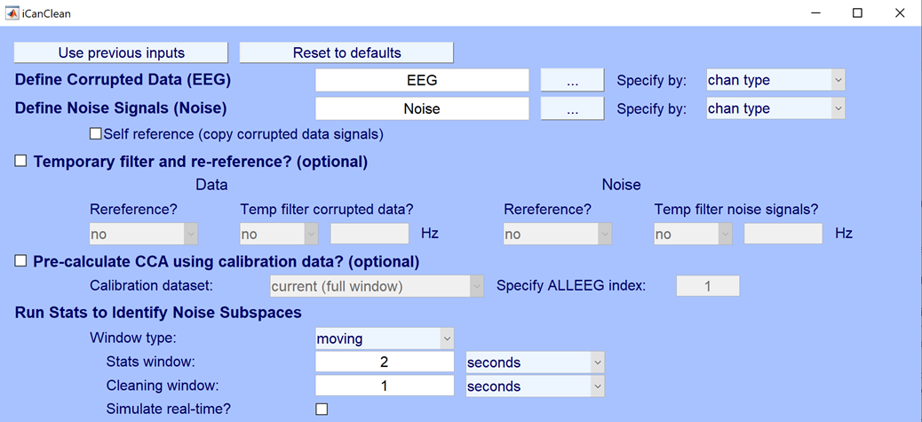
GUI and geometry variables comparison
Notice that empty spaces are considered GUI elements as well. Some empty spaces are extremely small, but still take up space on the GUI.

Slide 14
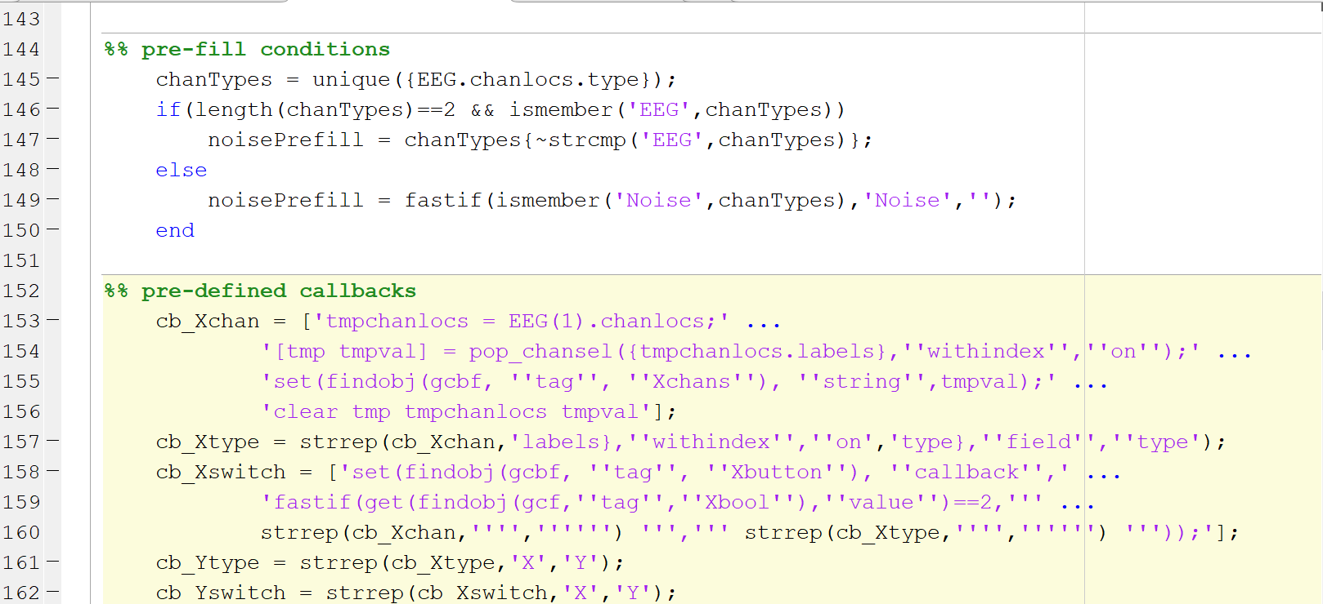
pop_iCanClean.m (2022-06-06), page 3
This section simply defines a variable, noisePrefill, that will be used later on when initializing the GUI.
A section for callbacks. These callbacks define behaviors for elements in our GUI.

Slide 15
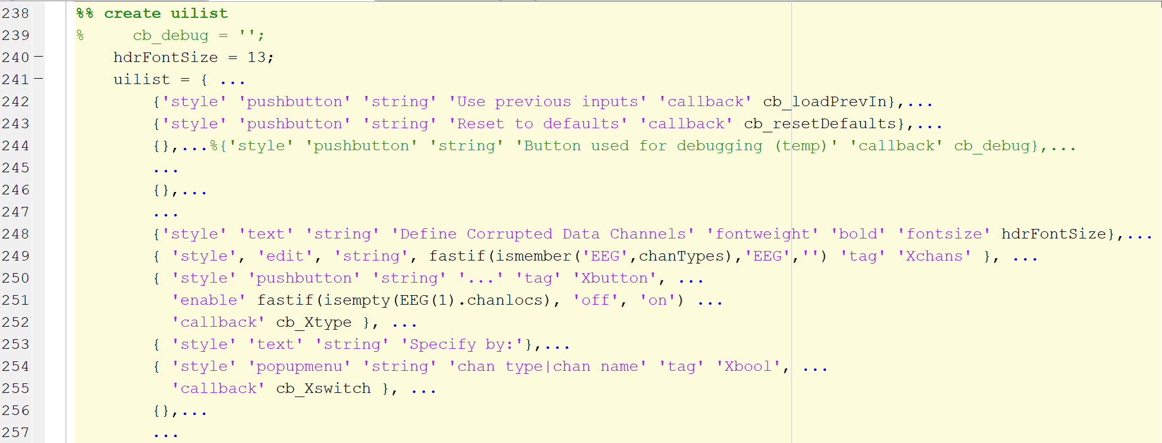
pop_iCanClean.m (2022-06-15), page 4
The uilist variable is a cell array of uicontrol property lists. Each list defines a GUI element that will populate a space defined by the geometry variable. Property lists follow the format {'PropertyName1',value1,'PropertyName2',value2,...}. These properties define how the GUI element will appear and behave. An empty property list {} will result in a blank space on the GUI. For more information, try >> help uicontrol in the MATLAB terminal.

Slide 16
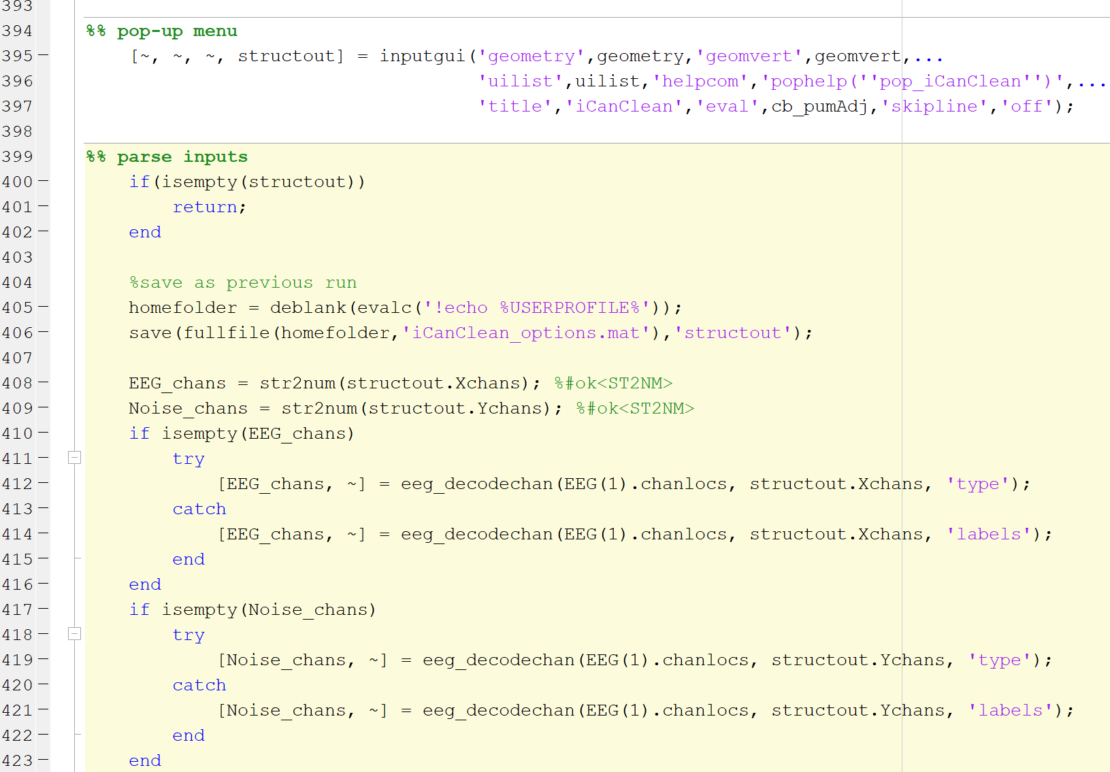
pop_iCanClean.m (2022-06-15), page 5
The inputgui function in an EEGLAB function that creates a GUI window based on the geometry, geomvert, and uilist variables. It returns values of tagged elements in the GUI in the structout variable. The fields of structout will correspond to the tag field of uilist elements.
This section parses the results of structout into a format useable by the signal processing function. The eeg_decodechan function is another EEGLAB function that converts a string containing a channel type or label into the corresponding numeric indices in the EEG structure.

Slide 17
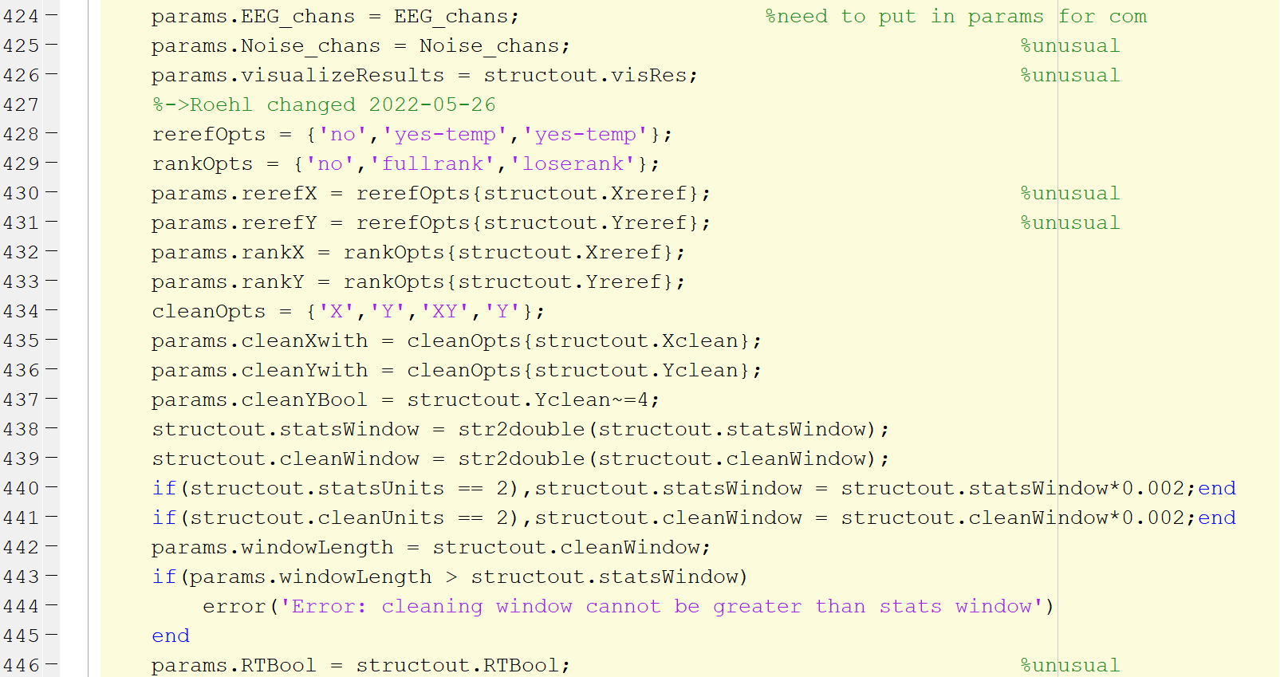
pop_iCanClean.m (2022-06-15), page 6
Here we define a new struct, params, that contains reformatted information from structout. This is done because structout is not in the proper format to be used by the signal processing function.
For instance, values from dropdown menus in the GUI are returned in structout as integers. For readability purposes, it is much more meaningful to keep those options as strings when passed to the signal processing function.

Slide 18
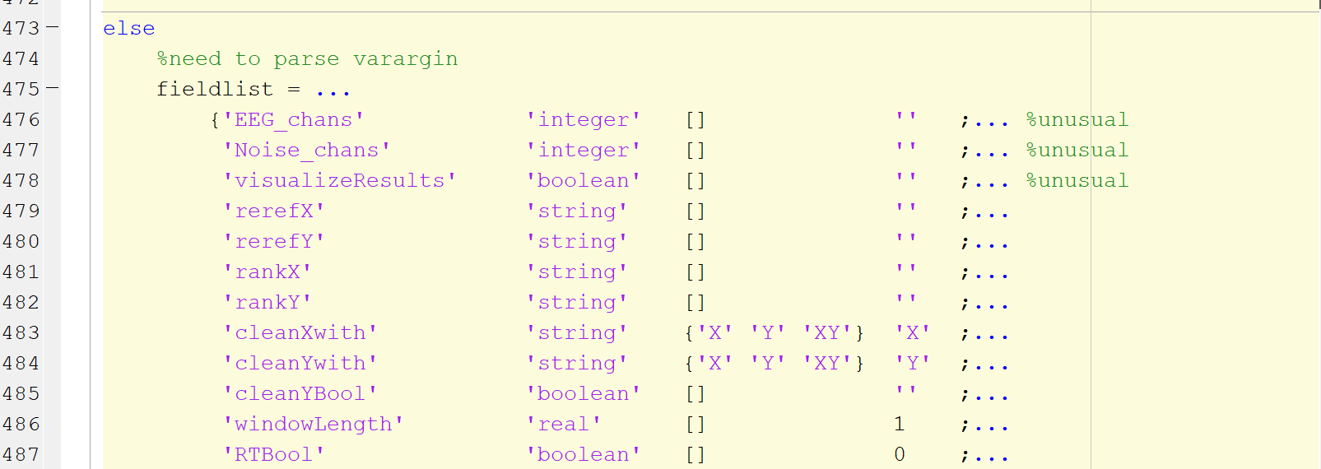
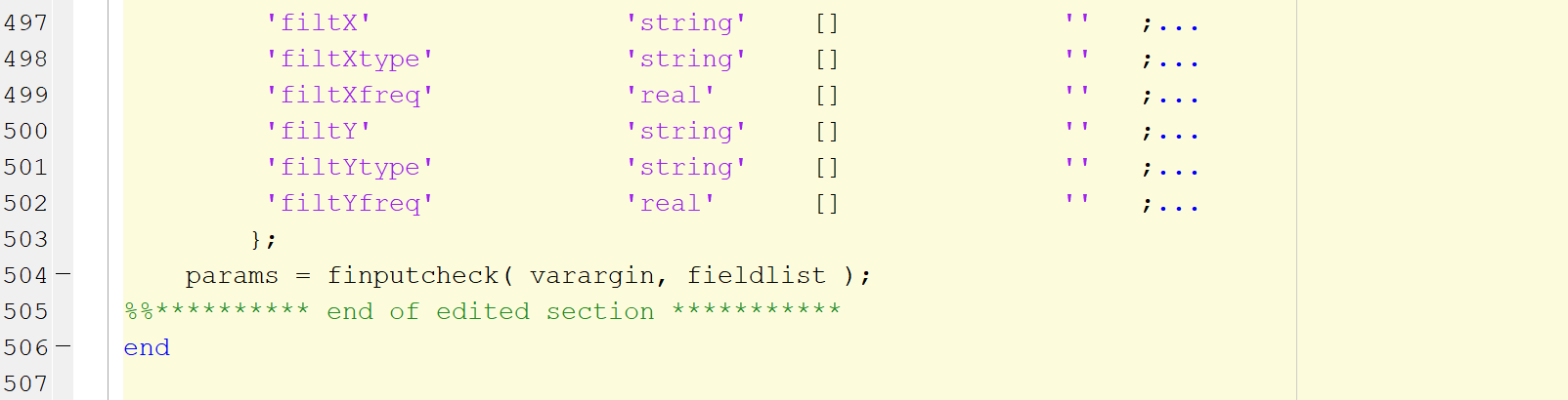
pop_iCanClean.m (2022-06-15), page 7
If 3 or more arguments are given, with additional arguments in the form of key-value pairs, then we skip the GUI entirely and define our params struct based on these arguments.
Another EEGLAB function, finputcheck, converts the key-value pairs from varargin into a struct with fields based on fieldlist. The rows of fieldlist follow the format {fieldname, data type, possible values, default value}. If a key-value pair in varargin matches the field name and accepted values in fieldlist, then the pair is added as a field in the params struct.

Slide 19
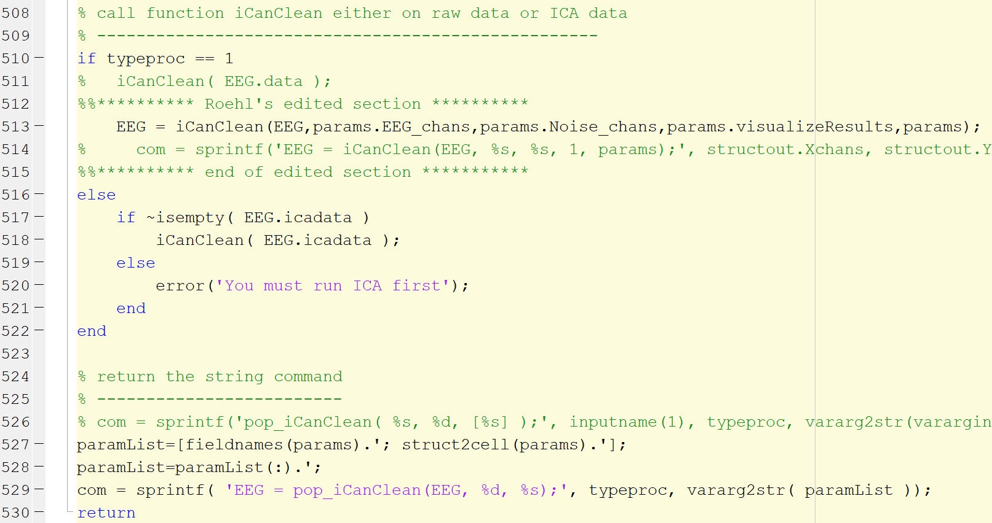
pop_iCanClean.m (2022-06-15), page 8
Here, the signal processing function, iCanClean, is called with arguments from the params structure.
A string containing the command is returned for the EEG history mechanism. Even if the GUI is used, we want the history to show the command line equivalent. A few conversions are done to turn the params struct into its string equivalent.

Slide 20
The signal processing function – general info
File name: iCanClean.m
What does it do?
Uses the iCanClean cleaning algorithm to remove artifacts from the input EEG dataset.
Additional arguments can add more processing steps such as filtering and re-referencing.
When to edit?
If you added a new option in the GUI and need to code the equivalent backend behavior.
In most cases, only edit this if certain parameter options are not being recognized. If there is an algorithmic error, talk to Ryan.

Slide 21
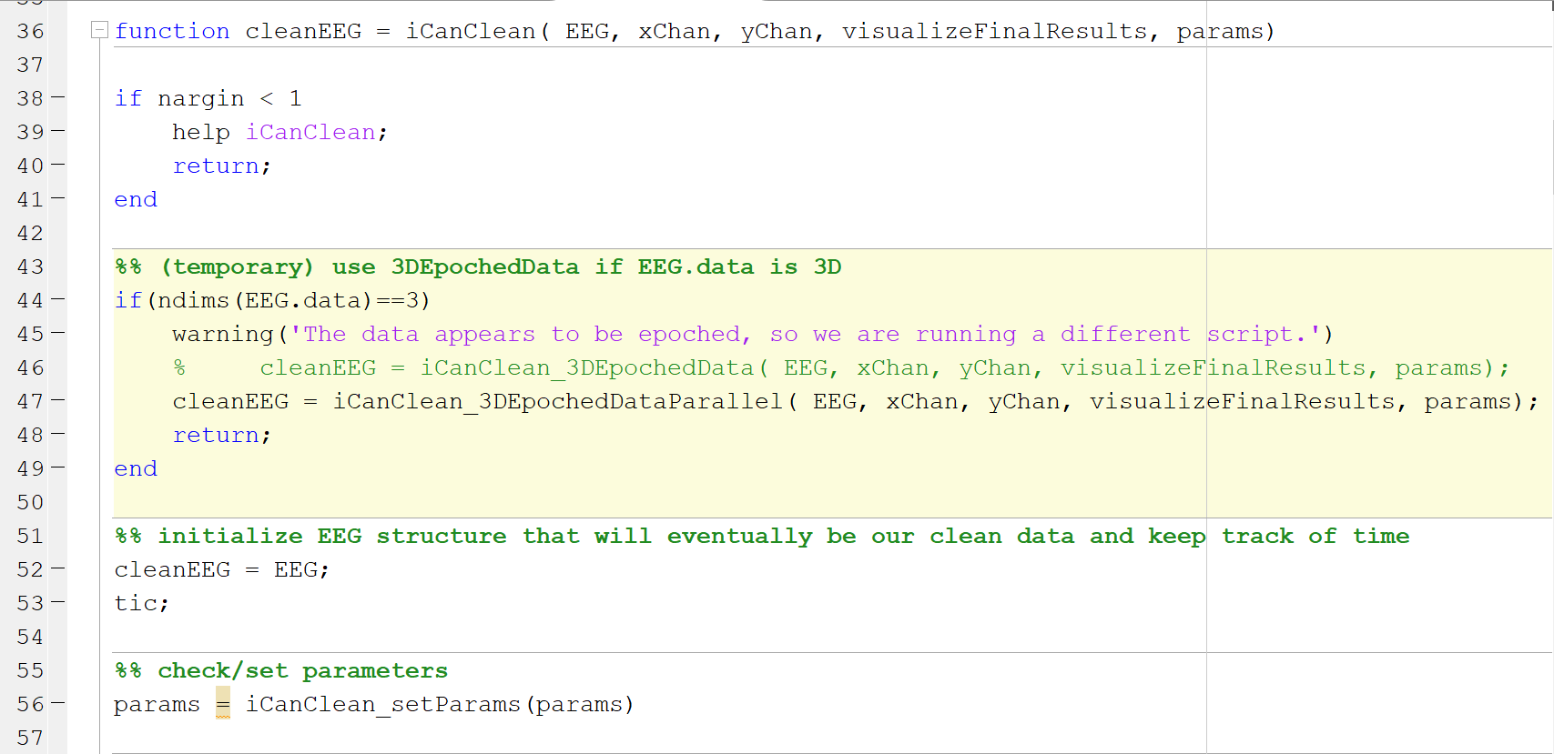
iCanClean.m (2022-06-21), page 1
Function inputs:
EEG – the EEG struct containing our dataset.
xChan – indices of the data channels
yChan – indices of the reference noise channels
visualizeFinalResults – option to turn on/off graph visualization of results
params – the params structure containing additional options
iCanClean_setParams is a sub-function that checks the validity of the params structure. Missing fields are given default values.

Slide 22
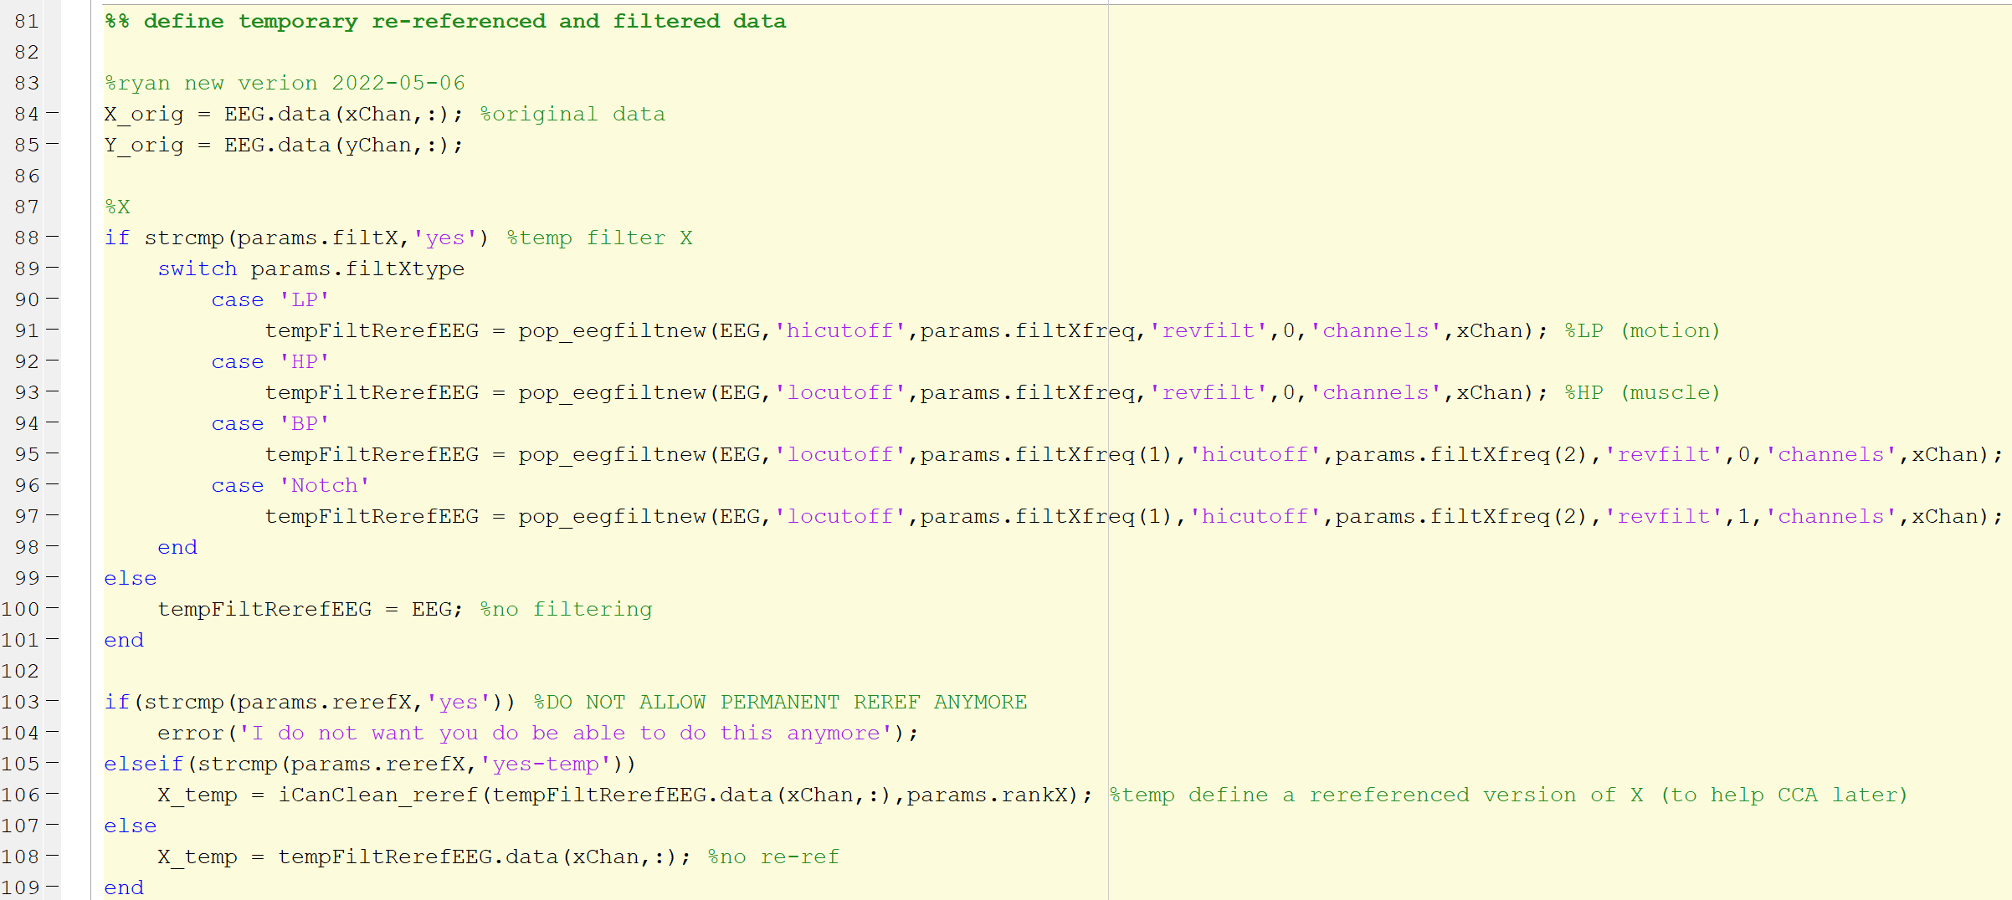
iCanClean.m (2022-06-21), page 2
This is the backend for the temporary preprocessing section of the GUI. All options specified there are used in this section of the code. This only shows the data channels (X) filtering and re-referencing sections; the same block of code is repeated for the reference noise channels (Y).

Slide 23
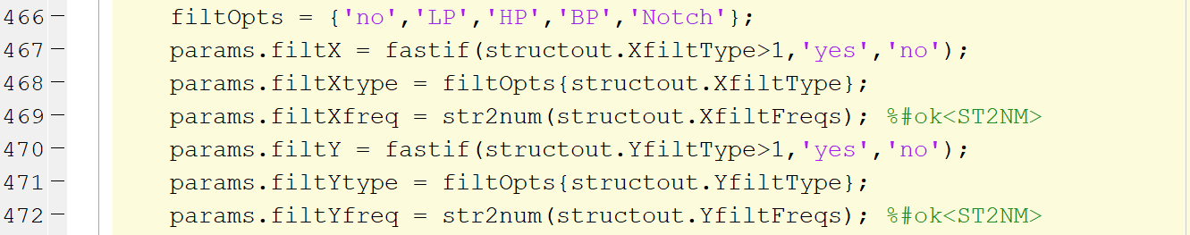
Frontend to Backend Comparison
1. User inputs desired GUI options
2. Options are parsed into function-compatible format
3. Parameters are read and the corresponding function is executed.

Slide 24
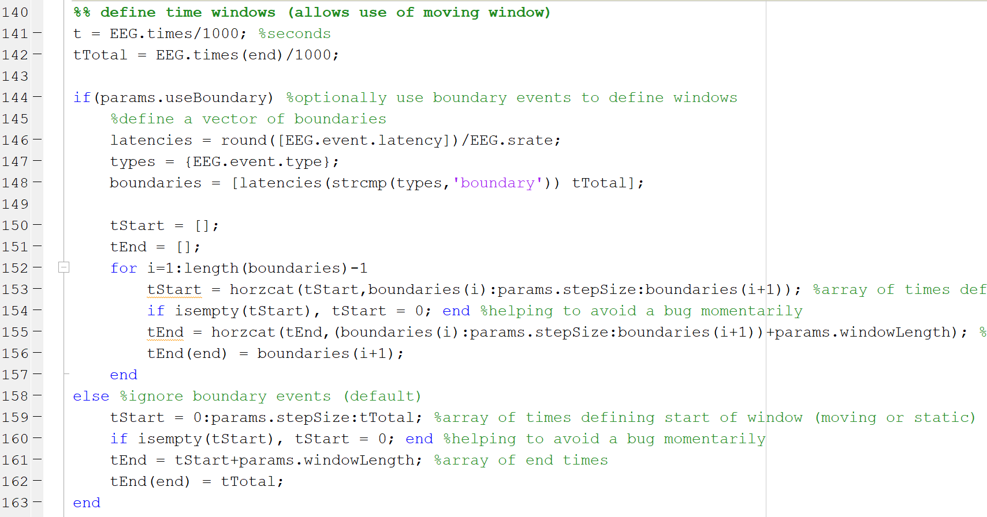
iCanClean.m (2022-06-21), page 3
Section for window options and boundary event handling.
If boundary events are respected, windows of equal length are created until the next boundary event. A new window starts directly on each boundary event, shortening the length of the previous window.
Otherwise, windows of equal length are created until the end of the recording.

Slide 25
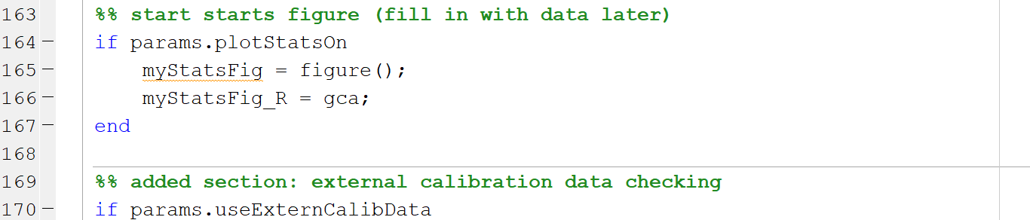
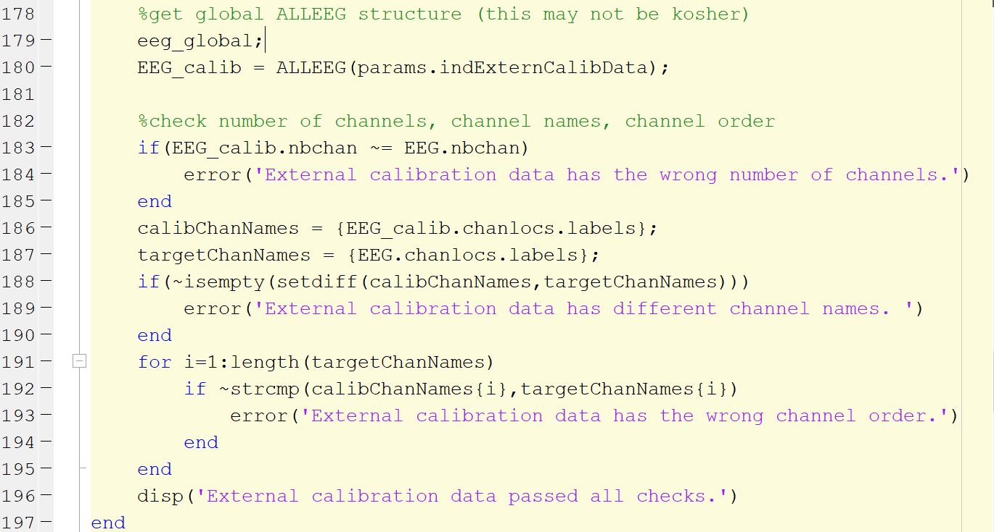
iCanClean.m (2022-06-21), page 4
Create figure to be used later on for plotting purposes.
If an external calibration dataset is selected, it needs to be checked for compatibility, which is done in this section of the code.
If the dataset passes all checks, a confirmation message is displayed.

Slide 26
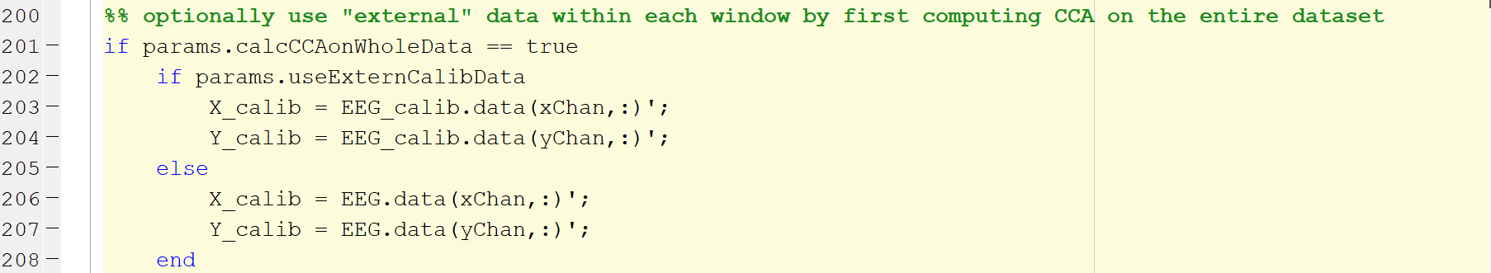
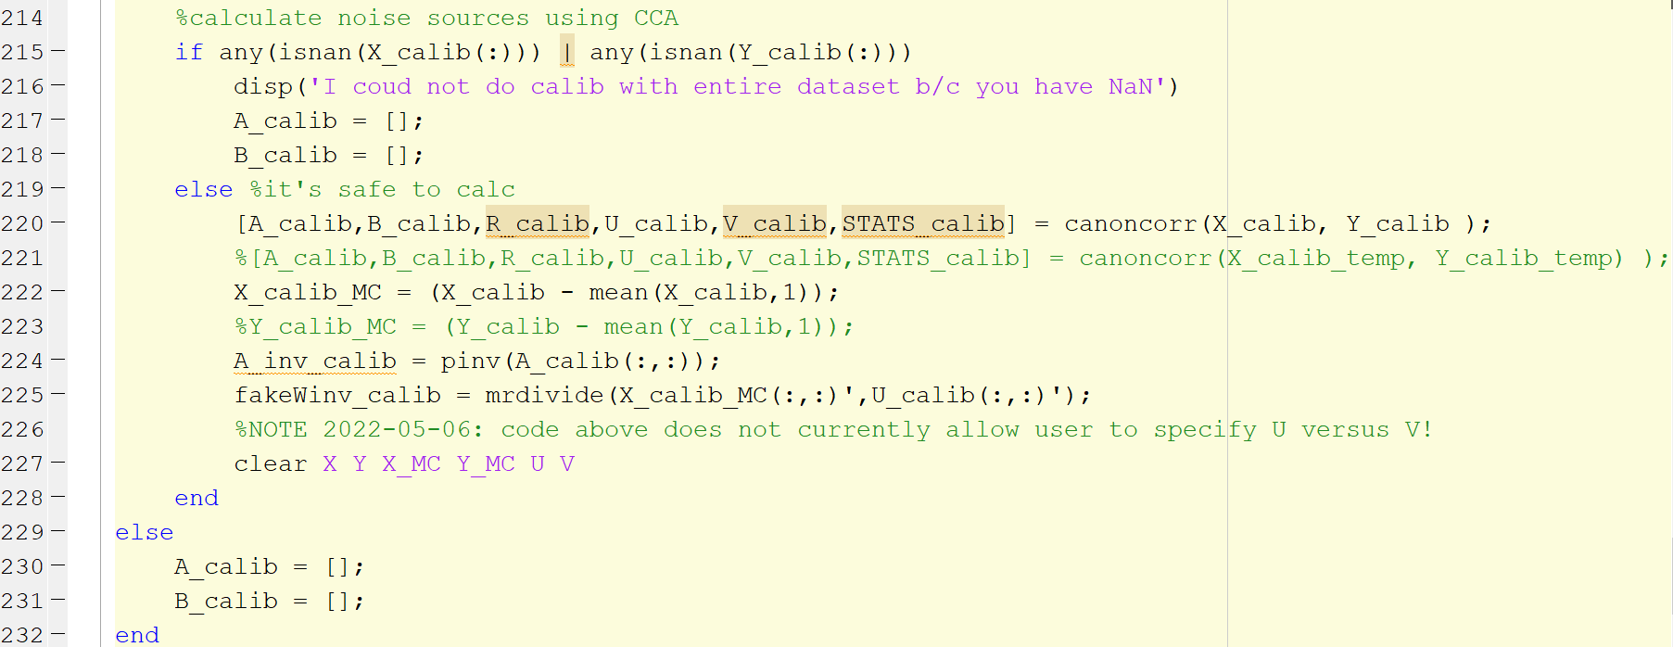
iCanClean.m (2022-06-21), page 5
After the external calibration dataset passes all checks, it is used in pre-computing CCA.
If the user opts to use the current dataset to pre-calculate CCA, it is handled in this section of the code as well.

Slide 27
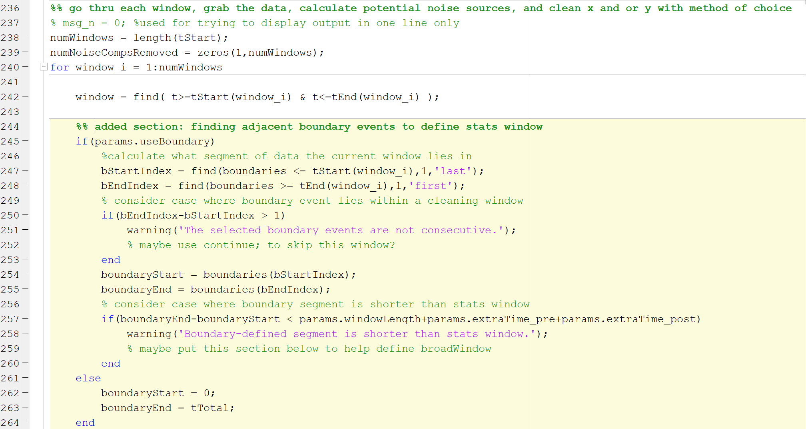
iCanClean.m (2022-06-21), page 6
This section shows the start of the cleaning process.
The for loop iterates through the cleaning windows defined earlier.
Larger windows, called stats windows, define a neighborhood of data for the cleaning to take place. These need to be calculated dynamically depending on whether boundary events are respected and whether the cleaning window is near the beginning or end of the recording.

Slide 28
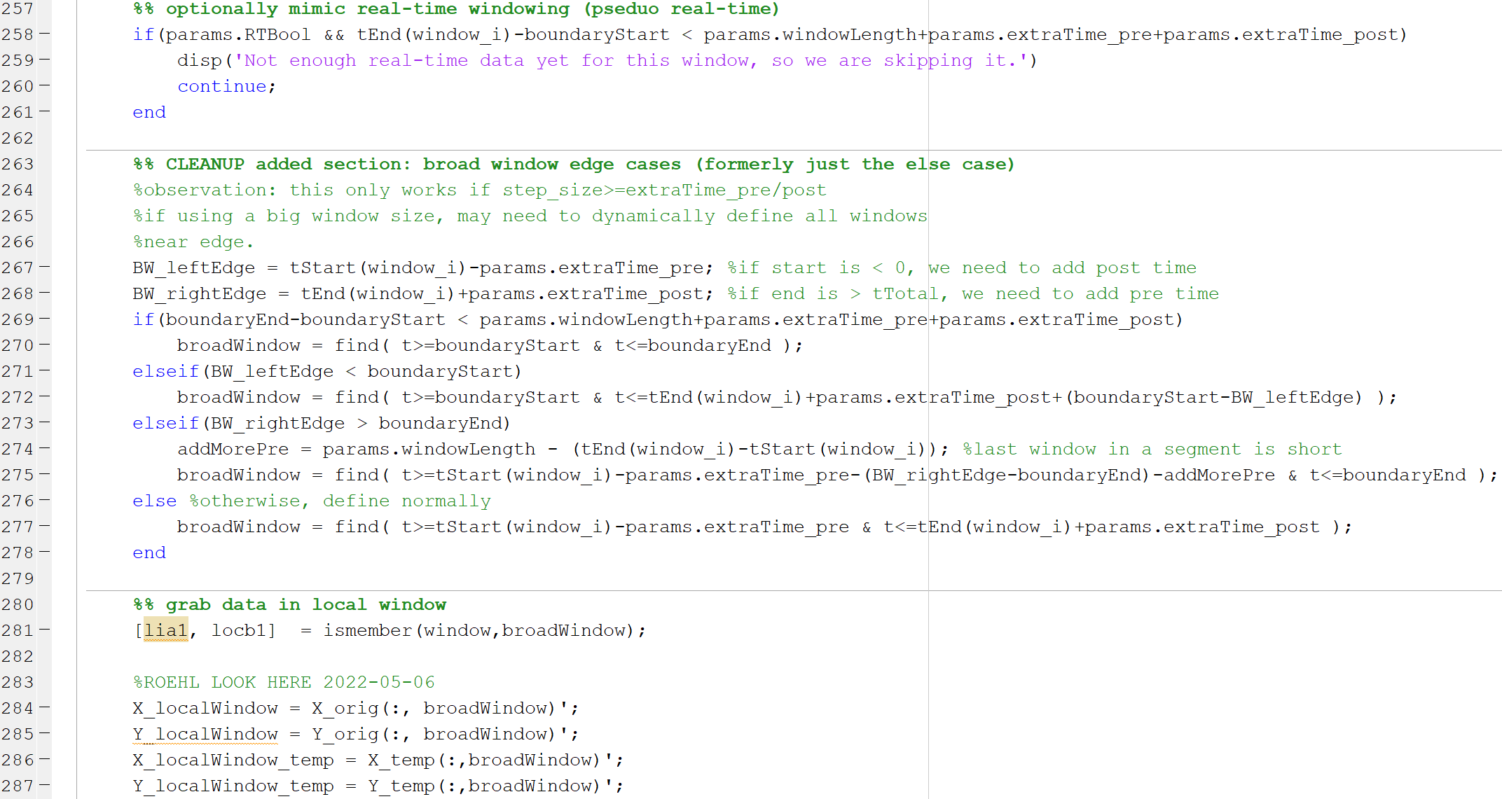
iCanClean.m (2022-06-21), page 7
For real-time simulation, stats windows are defined such that the neighborhood only includes previous data. If not enough data exist, the window is skipped.
Here the stats window is dynamically defined based on the surrounding boundaries.

Slide 29
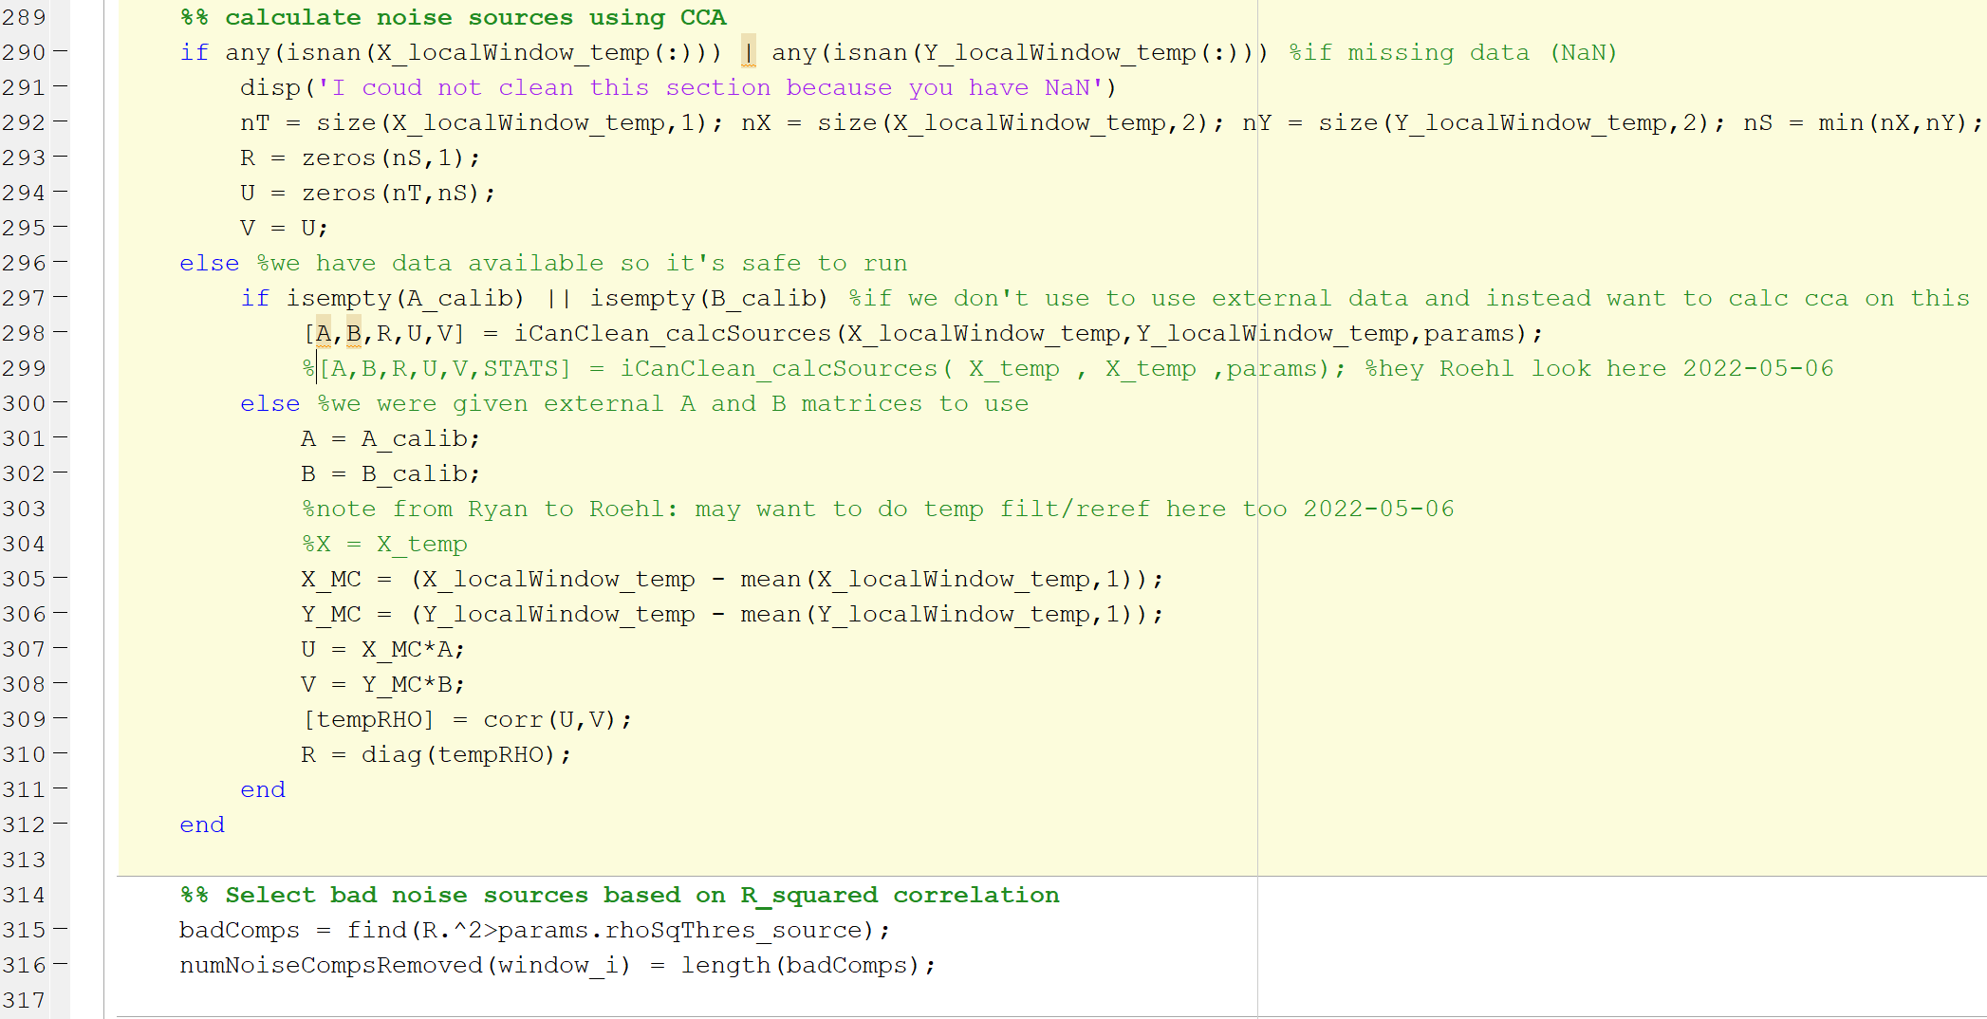
iCanClean.m (2022-06-21), page 8
For each stats window, the noise sources are calculated using CCA.
If any NaNs exist in the data window, the window is skipped;
Depending on the specified R² threshold, a number of noise components are removed.

Slide 30
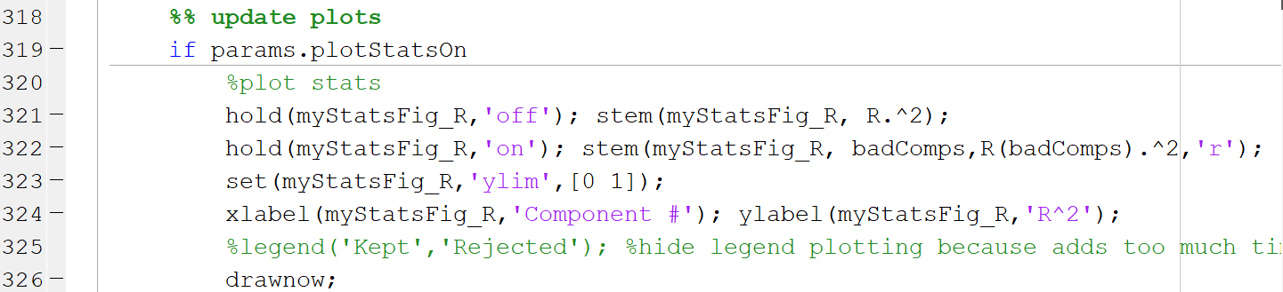
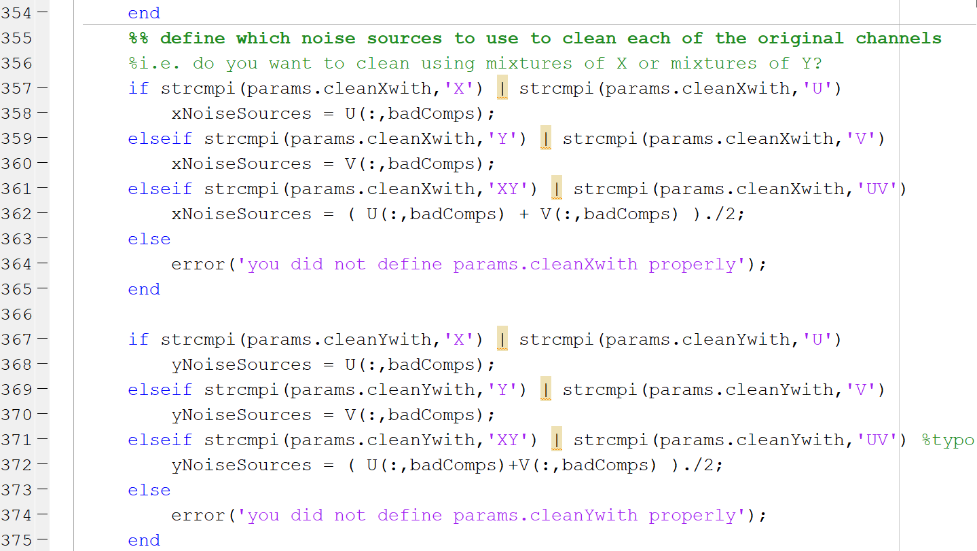
iCanClean.m (2022-06-21), page 9
Plotting option for visualizing the cleaning process.
This section corresponds to the Remove Bad Components section of the GUI. Depending on what the user specifies, different mixtures of noise sources are used to clean the data channels.

Slide 31
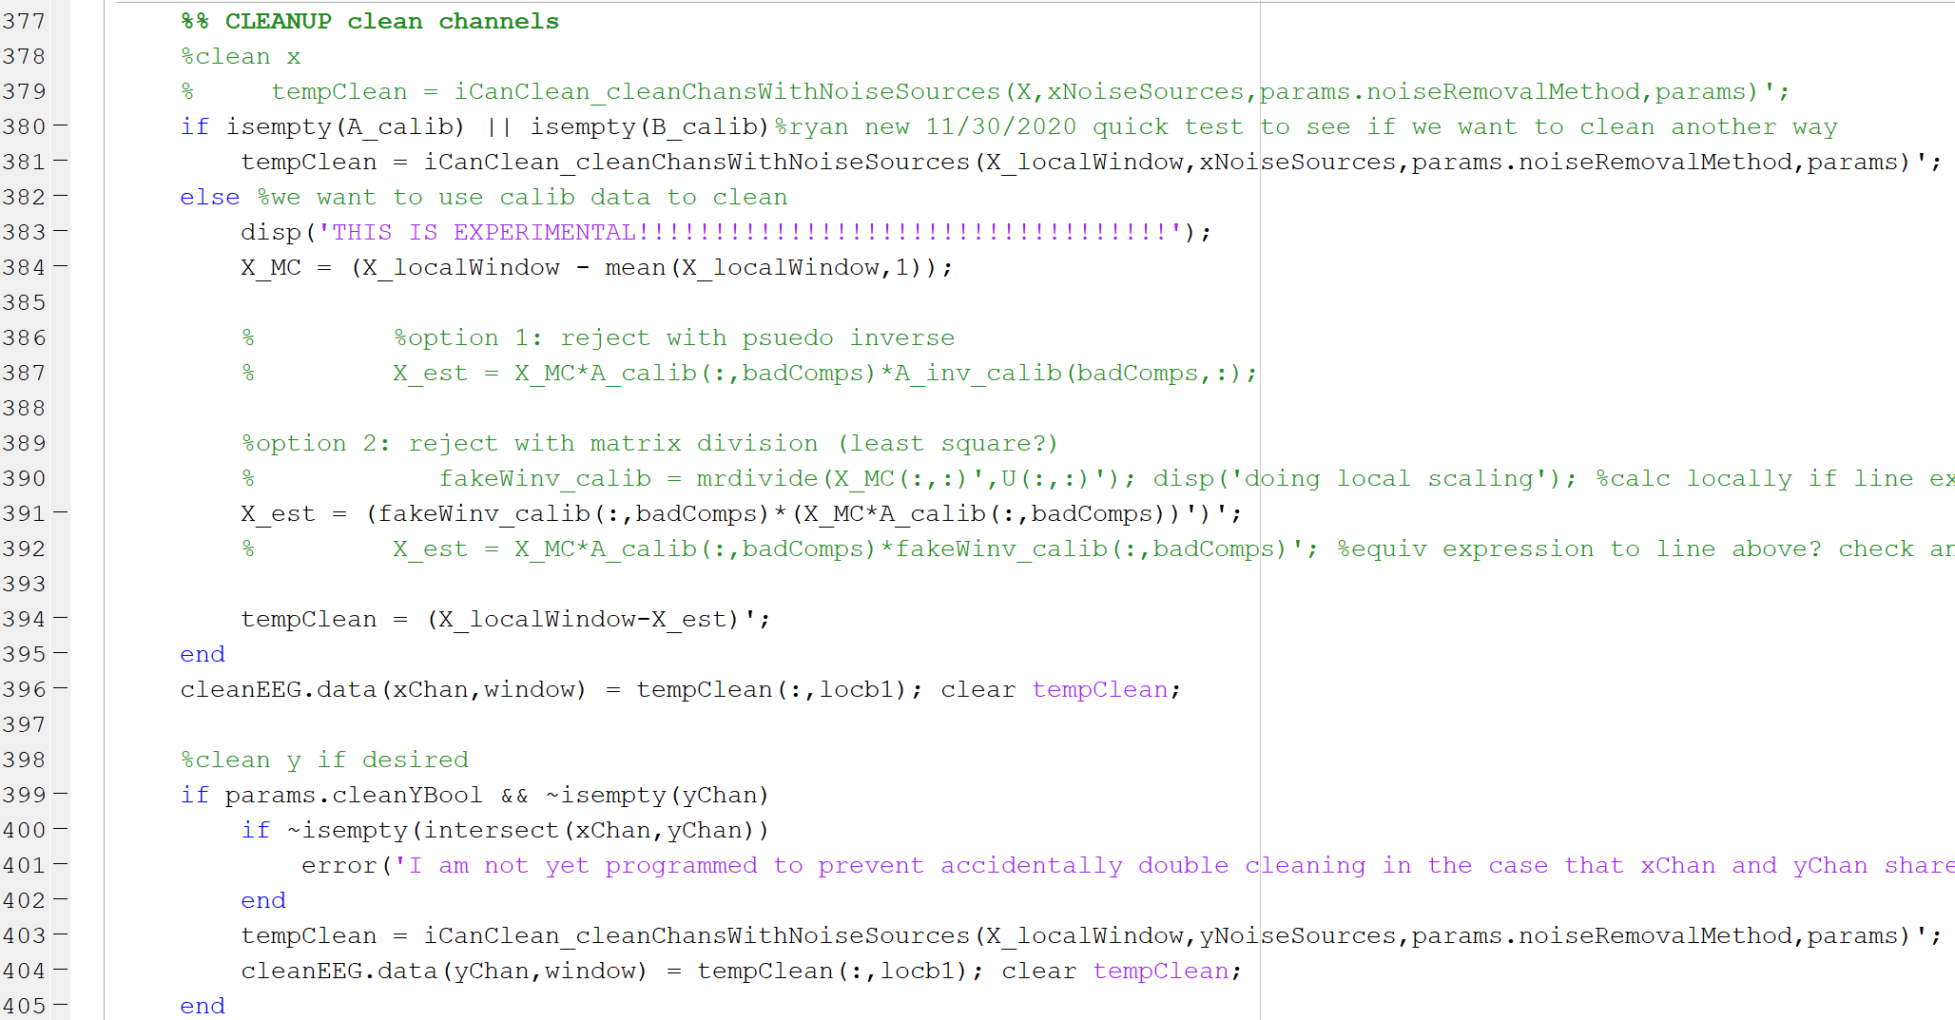
iCanClean.m (2022-06-21), page 10
Section for cleaning the channels.
The main function here is iCanClean_cleanChansWithNoiseSources which will clean each local window using a given set of reference noise sources.
The noise channels are cleaned as well, if specified by the user in the GUI.

Slide 32
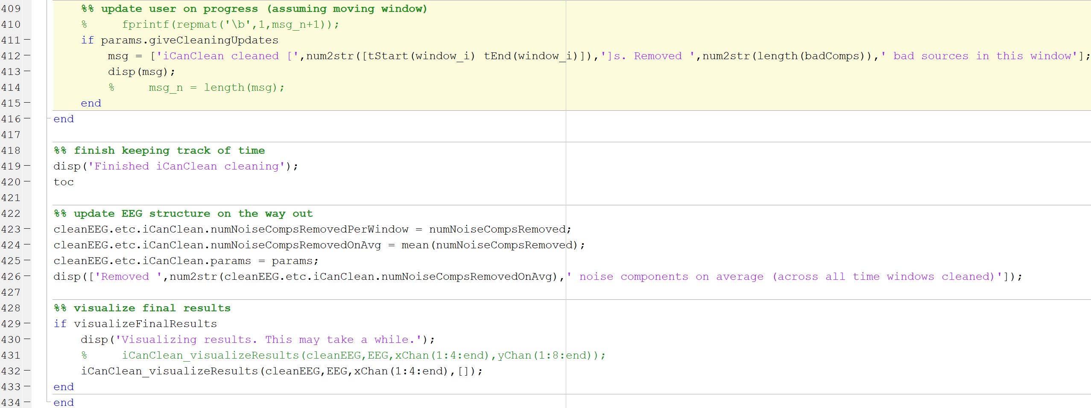
iCanClean.m (2022-06-21), page 11
End of the script – print progress messages in the command line, update EEG structure, and visualize final results.

Slide 33
References
For more general information about writing EEGLAB functions, please visit the EEGLAB website:
https://eeglab.org/tutorials/contribute/design_plugin.html

